Slide 1
Fourier Transform and Its Applications
Instructor
LE Thanh Sach, Ph.D.
Ltsach@cse.hcmut.edu.vn

Slide 2
Outline
Fourier Transform
Its Applications

Slide 3
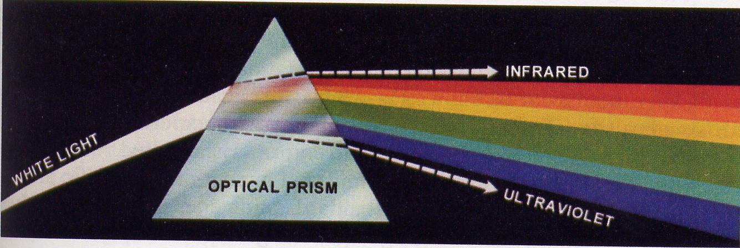
Fourier Analysis
White Light
Color lights
.
.
.
Signal
DFT
Signals with different frequencies

Slide 4
Fourier Theory
Any functions or signals =
Fourier
Fourier Series
Fourier Transform
Periodic function
Aperiodic function
Continuous
Discrete
Continuous
Discrete

Slide 5
1D Discrete Fourier Transform Formula
Forward Transform:
from space domain to frequency domain (Fourier Domain)
u = 0,1,.., M-1
Backward Transform (Inverse Transform):
from space domain to frequency domain (Fourier Domain)
x = 0,1,.., M-1

Slide 6
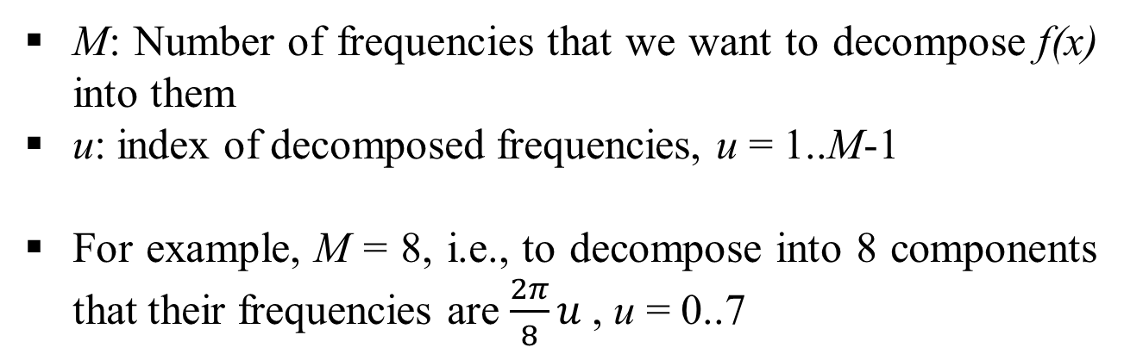
1D Discrete Fourier Transform Interpretation
Forward Transform:
M: Number of frequencies that we want to decompose f(x) into them
u: index of decomposed frequencies, u = 1..M-1
For example, M = 8, i.e., to decompose into 8 components that their frequencies are $\frac{2π}{8}u$, u = 0..7

Slide 7
1D Discrete Fourier Transform Interpretation
ω=π/2
u=2
u=3
ω=3π/4
ω=π/4
u=1
M frequencies
in a trigonometric circle,
For M = 8:
u=4
ω=π
ω=0
u=0
u=5
ω=5π/4
ω=7π/4
u=7
ω=3π/2
u=6

Slide 8
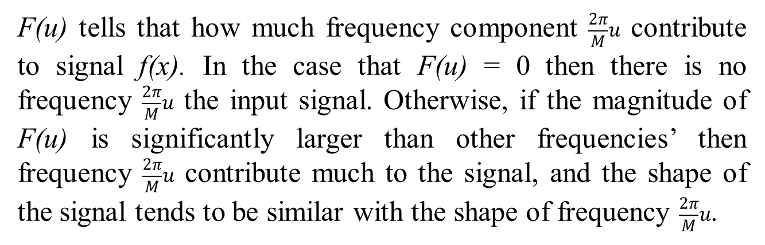
1D Discrete Fourier Transform Interpretation
Fourier transform’s meaning:
u = 0,1,.., M
F(u) tells that how much frequency component $\frac{2π}{M}u$ contribute to signal f(x). In the case that F(u) = 0 then there is no frequency $\frac{2π}{M}u$ the input signal. Otherwise, if the magnitude of F(u) is significantly larger than other frequencies’ then frequency $\frac{2π}{M}u$ contribute much to the signal, and the shape of the signal tends to be similar with the shape of frequency $\frac{2π}{M}u$.

Slide 9
1D Discrete Fourier Transform Interpretation
Fourier transform meaning:
u = 0,1,.., M
In dot product/ correlation

Slide 10
1D Discrete Fourier Transform Interpretation
Fourier transform’s meaning:
Magnitude spectrum: display the magnitude of Fourier coefficients among frequency components. This spectrum can tell how much a frequency contribute to the input signal.
Phase spectrum: display the phase of Fourier coefficients among frequency components. This spectrum shows the contribution in phase.
magnitude/phase
frequency

Slide 11
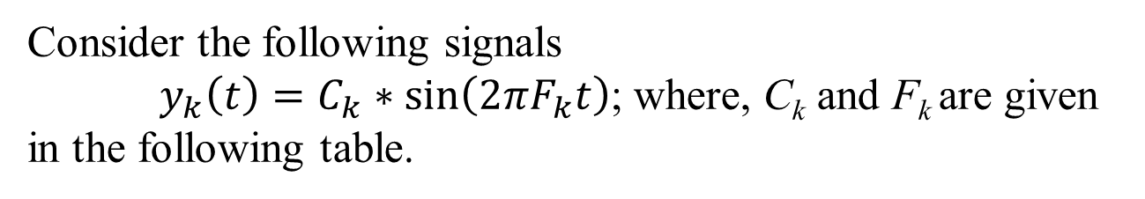
1D Discrete Fourier Transform Interpretation
Fourier transform’s meaning:
Consider the following signals
$y_{k}\left(t\right)=C_{k}∗sin\left(2πF_{k}t\right)$; where, C_{k} and F_{k} are given in the following table.
k | F_{k} (Hertz) | C_{k}
1 | 50 | 50
2 | 100 | 7
3 | 200 | 20
4 | 250 | 5
5 | 300 | 0.5

Slide 12
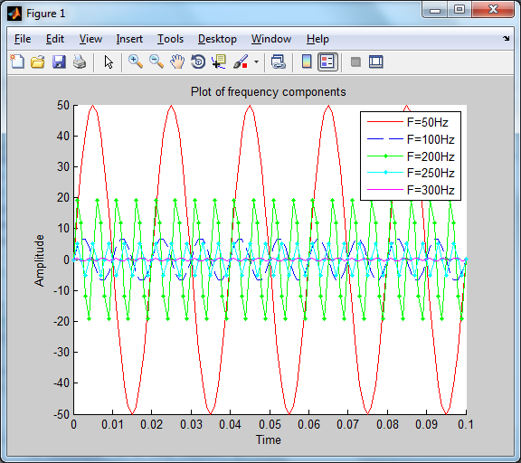
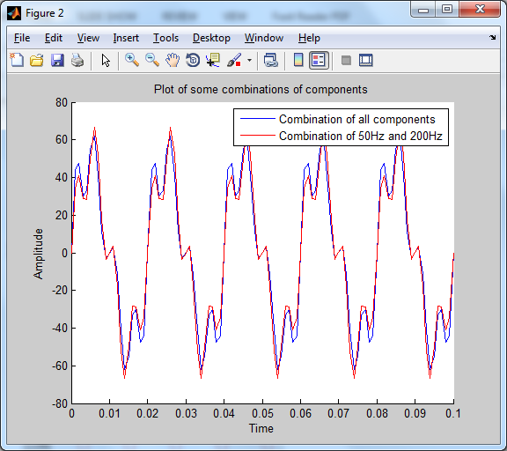
1D Discrete Fourier Transform Interpretation
Fourier transform’s meaning:
A combination of only significantly contributed components can approximate the signal that contains all the components.

Slide 13
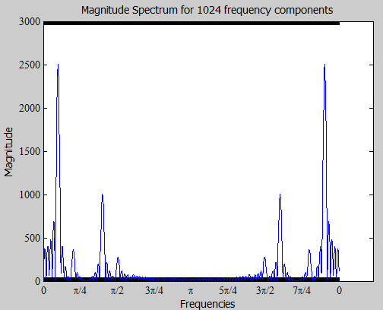
1D Discrete Fourier Transform Interpretation
Fourier transform’s meaning:
F₁ = 50Hz
F₂ = 100Hz
F₃ = 200Hz
F₄ = 250Hz
F₅ = 300Hz

Slide 14
1D Discrete Fourier Transform Matrix form
Example for M = 4
x=0
x=1
x=3
x=4
Kernel Matrix:
u=0
u=1
u=2
u=3

Slide 15
1D Discrete Fourier Transform Matrix form

Slide 16
1D Discrete Fourier Transform Matrix form
Example for M = 4
Vector signal:

Slide 17
1D Discrete Fourier Transform Matrix form
Matrix
Vector

Slide 18
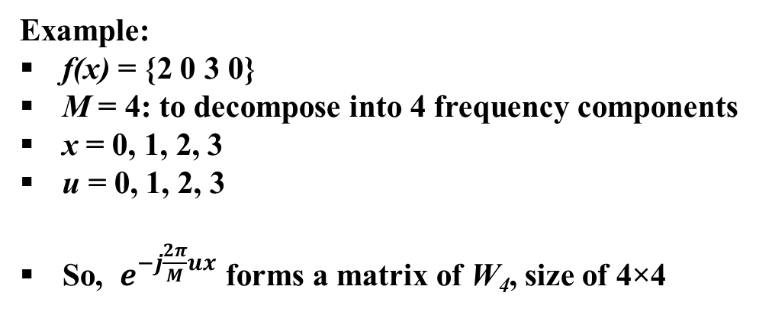
1D Discrete Fourier Transform Example
Example:
f(x) = {2 0 3 0}
M = 4: to decompose into 4 frequency components
x = 0, 1, 2, 3
u = 0, 1, 2, 3
So, $e^{−j\frac{2π}{M}ux}$ forms a matrix of W₄, size of 4×4

Slide 19
1D Discrete Fourier Transform Example

Slide 20
1D Discrete Fourier Transform Example
5
magnitude
1
frequency
(u=0)
(u=1)
(u=2)
(u=3)
Magnitude spectrum
phase
frequency
(u=0)
(u=1)
(u=2)
(u=3)
Phase spectrum

Slide 21
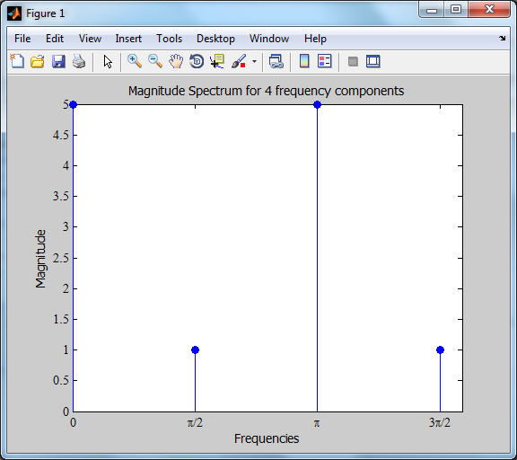
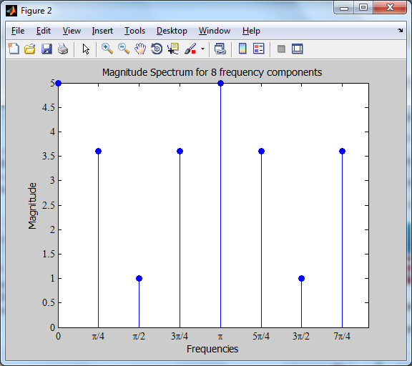
1D Discrete Fourier Transform Example
F(ω =0) = F(ω = π) = 5
F(ω = π/2) = F(ω = 3π/2) = 1

Slide 22
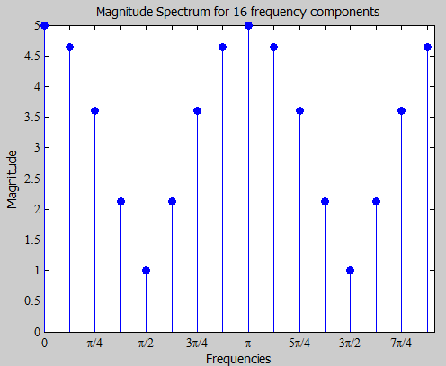
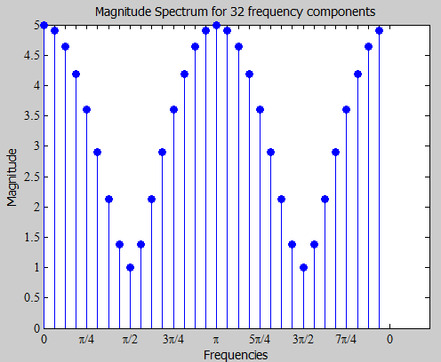
1D Discrete Fourier Transform Example
F(ω =0) = F(ω = π) = 5
F(ω = π/2) = F(ω = 3π/2) = 1

Slide 23
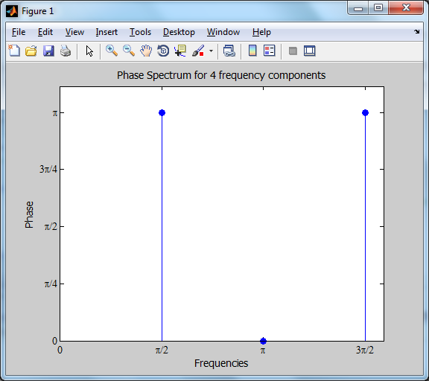
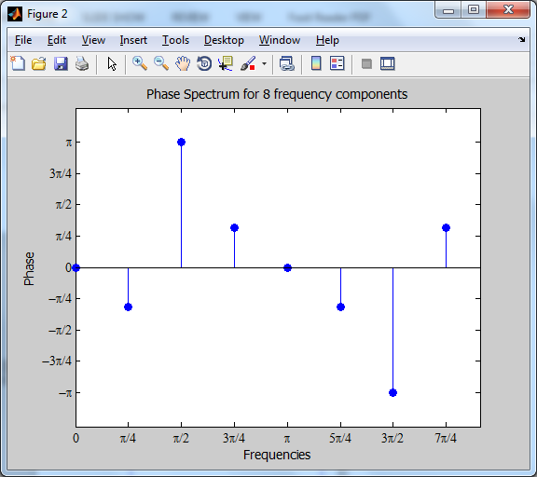
1D Discrete Fourier Transform Example
F(ω =0) = F(ω = π) = 0 (radian)
F(ω = π/2) = F(ω = 3π/2) = π (or - π, the same value)

Slide 24
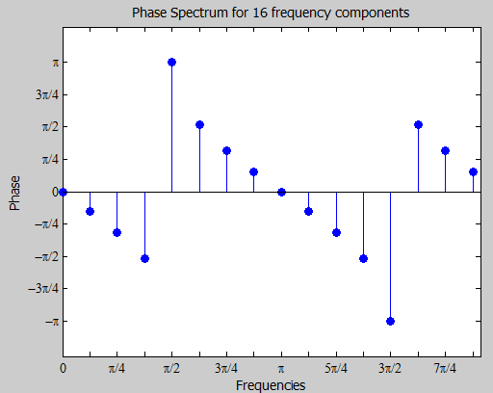
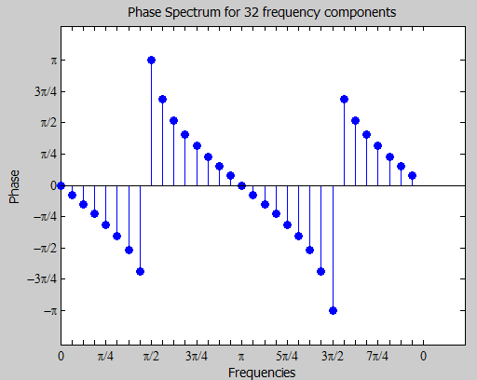
1D Discrete Fourier Transform Example
F(ω =0) = F(ω = π) = 0 (radian)
F(ω = π/2) = F(ω = 3π/2) = π (or - π, the same value)

Slide 25
1D Discrete Fourier Transform Matrix form
Kernel Matrix:
x=0
x=1
x=3
x=4
…
u=0
u=1
u=2
u=3
…

Slide 26
1D Discrete Fourier Transform Matrix form
Kernel Matrix:
x=0
x=1
x=3
x=4
…
u=0
u=1
u=2
u=3
…

Slide 27
1D Discrete Fourier Transform Matrix form
Kernel Matrix:

Slide 28
1D Discrete Fourier Transform Matrix form
Kernel Matrix’s Properties:
Symmetric on the main diagonal
Let
Then

Slide 29
1D Discrete Fourier Transform Question
Signal:
= ?
Draw magnitude and phase spectrum for F(u)
How much does frequency ω = 3π/4 contribute to the signal (in magnitude and in phase)?
Write Matlab/C/CPP function program to compute DFT/FFT.
Let M₁ = 256 and M₂= 8 be number of frequency into which we decompose, and F₂₅₆(u) and F₈(u) are Fourier coefficients for those two transforms. Assume that we already have F₂₅₆(u), how can obtain F₈(u) from F₂₅₆(u)?

Slide 30
2D Discrete Fourier Transform Formula
Forward transform:
u=0..M-1
v=0..N-1
Backward transform:
x=0..M-1
y=0..N-1

Slide 31
2D Discrete Fourier Transform Computation

Slide 32
2D Discrete Fourier Transform Computation
1D DFT for rows
1D DFT for columns

Slide 33
2D Discrete Fourier Transform Computation
0
π
2π
1D DFT for rows
1D DFT for columns
0
π
2π
0
π
2π

Slide 34
2D Discrete Fourier Transform Computation
Low frequencies are at four corners
High frequencies are at the center
Low frequencies mean intensities inside the input images have small variation. For example, perfectly smooth image has only one frequency, 0 radian.
0
π
2π
0
π
2π

Slide 35
2D Discrete Fourier Transform Computation
Low frequencies are at four corners
High frequencies are at the center
High frequencies mean the image has a large variation. For example, images have high variation around their edges.
0
π
2π
0
π
2π

Slide 36
2D Discrete Fourier Transform Computation
DFT are periodic on both of horizontal and vertical directions, as shown in the next slide
So, SHIFT (or swap) the diagonal direction to place low frequencies at the center of spectrum.
Why shift? Coefficients (or contribution) of low frequencies are usually significant larger than high frequencies’
0
π
2π
0
π
2π

Slide 37
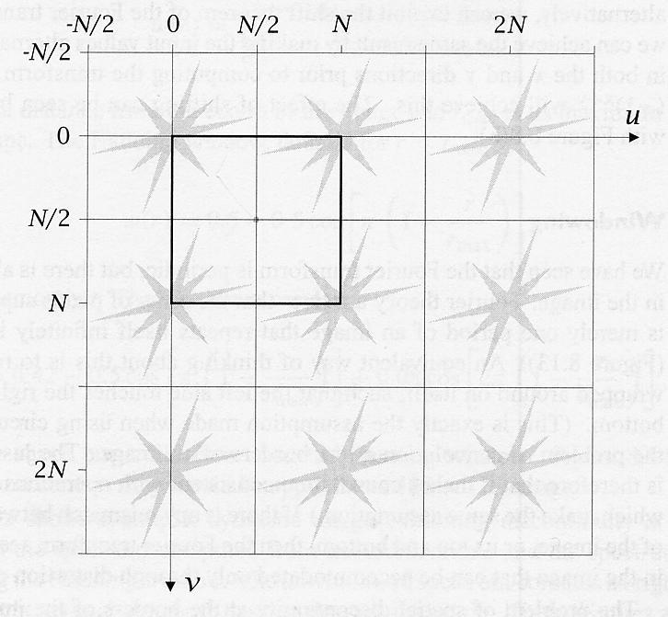
Fourier Transform property (1)
(*: conjugate)
1 = 4*
1
2
2 = 3*
3
4

Slide 38
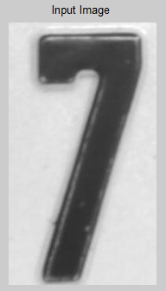
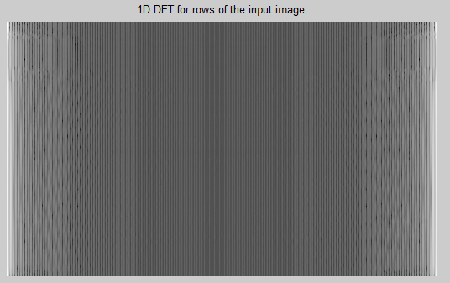
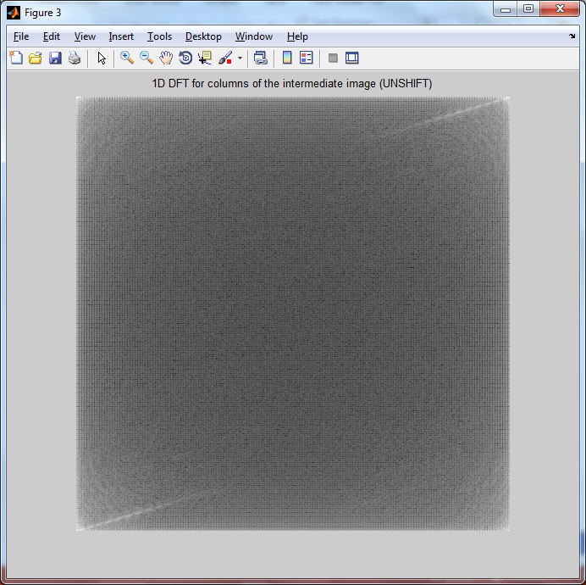
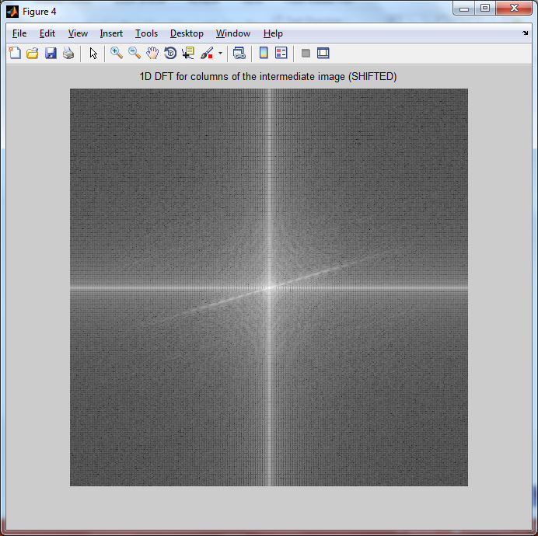
2D Discrete Fourier Transform Computation
DFT for rows
(Enhanced by Gamma, γ=0.1)
DFT for columns
Shift
Enhanced by (1+ Log)

Slide 39
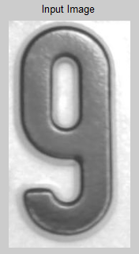
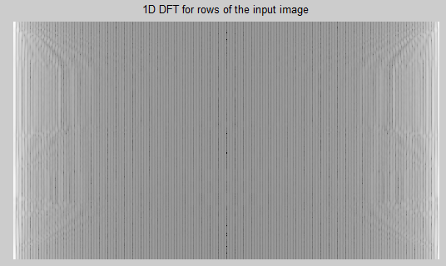
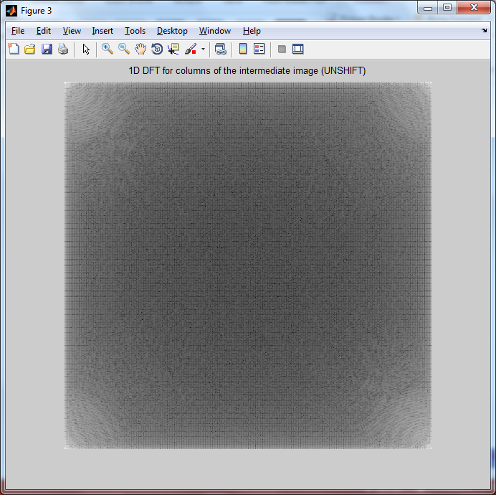
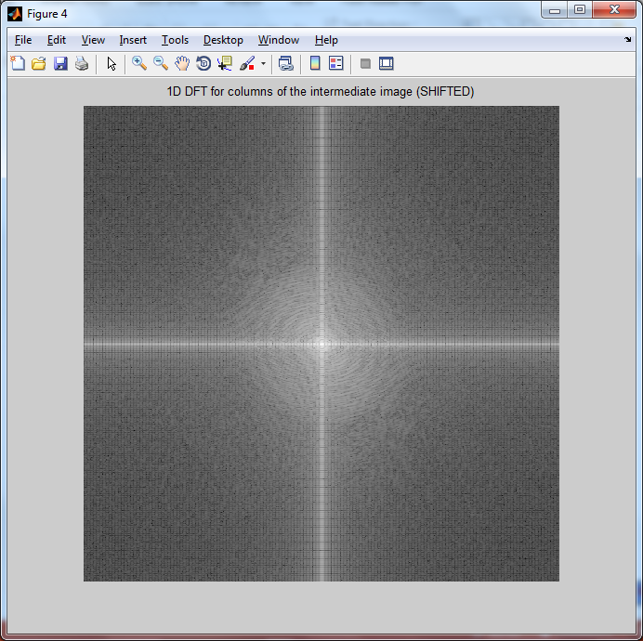
2D Discrete Fourier Transform Computation
DFT for rows
(Enhanced by Gamma, γ=0.1)
DFT for columns
Shift
Enhanced by (1+ Log)

Slide 40
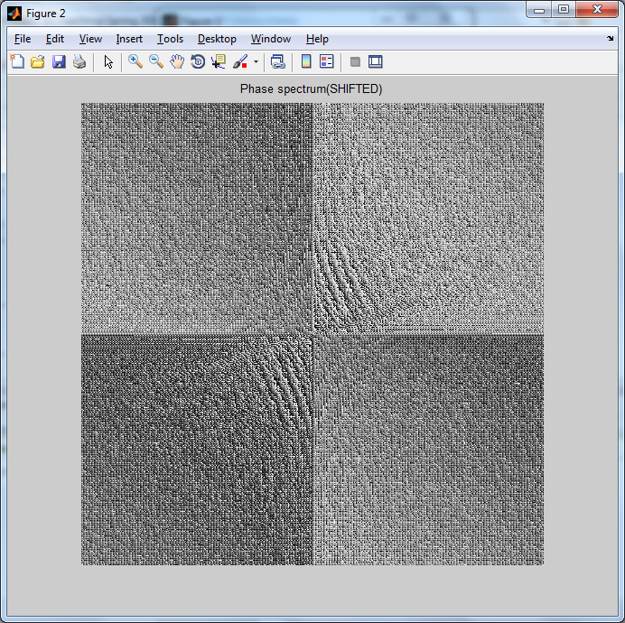
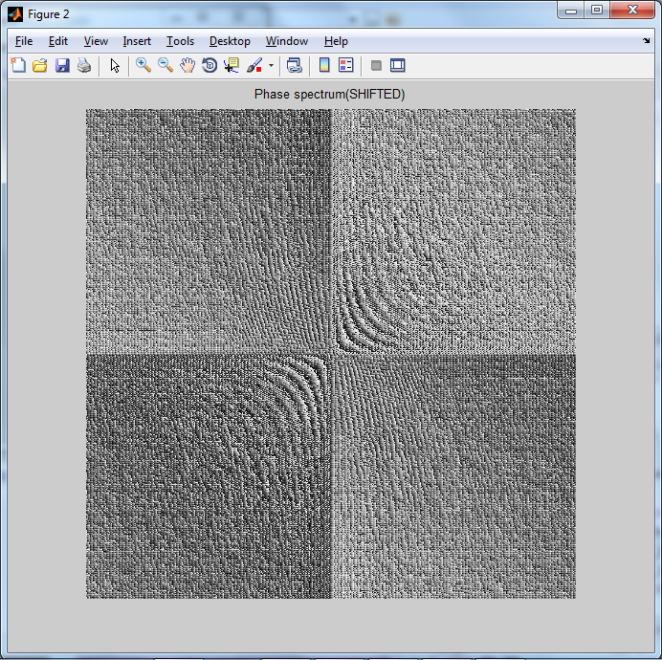
2D Discrete Fourier Transform Computation

Slide 41
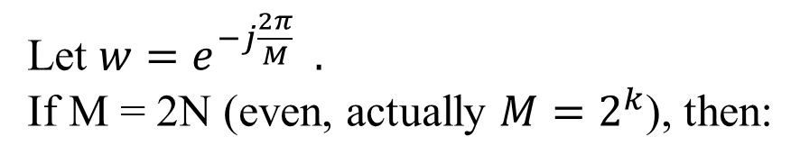
Fast Fourier Transform Computation
Let $w=e^{−j\frac{2π}{M}} .$
If M = 2N (even, actually $M=2^{k}$), then:

Slide 42
Fast Fourier Transform Computation

Slide 43
Fast Fourier Transform Computation
u = 0..M-1
= 0..2N-1
u = 0..N-1
u = 0..N-1

Slide 44
Fast Fourier Transform Computation

Slide 45
Fast Fourier Transform Computation

Slide 46
DIT-FFT (Scalable) (1)
2-point FFT
butterfly
a
2-point
FFT
a+b
a
a+b
b
a-b
b
a-b
-
1
4-point FFT
weight
butterfly
f(0)
F(0)
2-point
FFT
f(2)
F(1)
f(1)
F(2)
2-point
FFT
-
1
f(3)
F(3)
-
1

Slide 47
DIT-FFT (Scalable) (2)
8-point FFT
weight
butterfly
f(0)
F
F
(
(
0
0
)
)
f(4)
4-point
FFT
F
F
(
(
1
1
)
)
f(2)
F
F
(
(
2
2
)
)
f(6)
F
F
(
(
3
3
)
)
f(1)
F
F
(
(
4
4
)
-
)
-
1
W
0
1
W
0
8
f(5)
4-point
FFT
8
F
F
(
(
5
5
)
-
)
-
1
W
1
1
W
1
8
f(3)
8
F
F
(
(
6
6
)
-
)
-
1
W
2
1
W
2
8
f(7)
8
F
F
(
(
7
7
)
-
)
-
1
W
3
1
W
3
8
8

Slide 48
Fast Fourier Transform (DIT-FFT)
Direct calculation = N²
FFT = Nlog₂N
8-point FFT

Slide 49
Fast Fourier Transform
Computational Complexity:
Remember: The Fast Fourier Transform is just a faster algorithm for computing the Discrete Fourier Transform — it does not produce a different result.
Discrete Fourier Transform | → | O(N²)
Fast Fourier Transform | → | O(N log N)

Slide 50
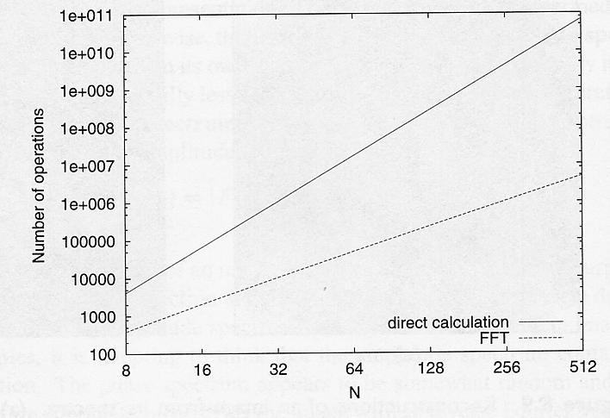
Processing Time (DFT vs FFT)

Slide 51
Relationship between Convolution and DFT

Slide 52
Comparison of Convolution and FFT
Convolution
FFT
Computational Process
Simple
Complex with many steps
Number of Multiplications
N x N -> image size
n x n -> filter window size

Slide 53
Number of Multiplication (FFT vs Convolution)

Slide 54
Filtering in Frequency Domain
f(x,y)
F(u,v)
F(u,v)H(u,v)
Shift
DFT
H(u,v)
IDFT
(-1)^{x+y}
Shift
(-1)^{x+y}
g(x,y)

Slide 55
Fourier Transform Applications: Image Enhancement and Restoration
Digital Image
from sensor
Better quality
Image
Too dark, Too bright, or Noisy
Pixel (Spatial Domain)
Frequency Domain
i/p
Frequency Transform
Adjust freq. coefficient
Inverse Transform
o/p

Slide 56
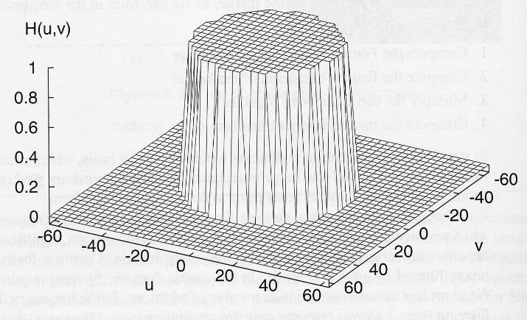
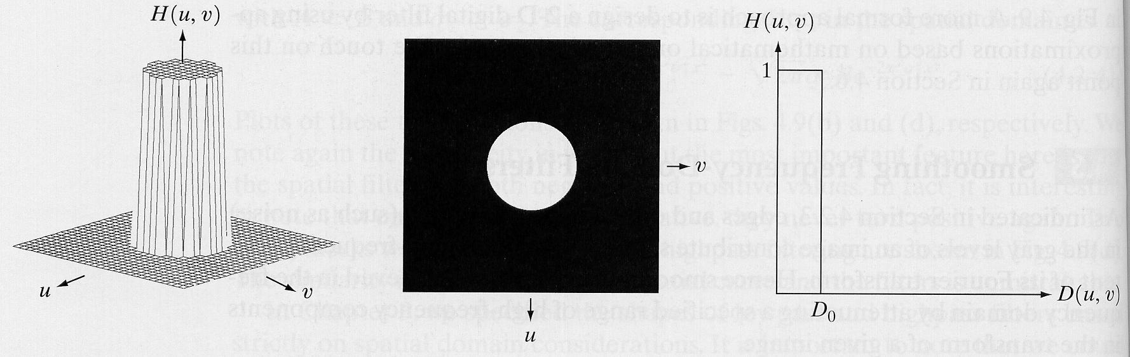
Ideal Low Pass Filter (ILPF)

Slide 57
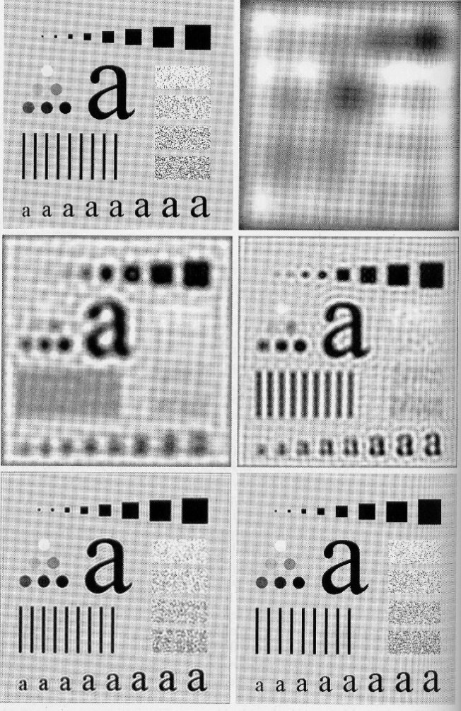
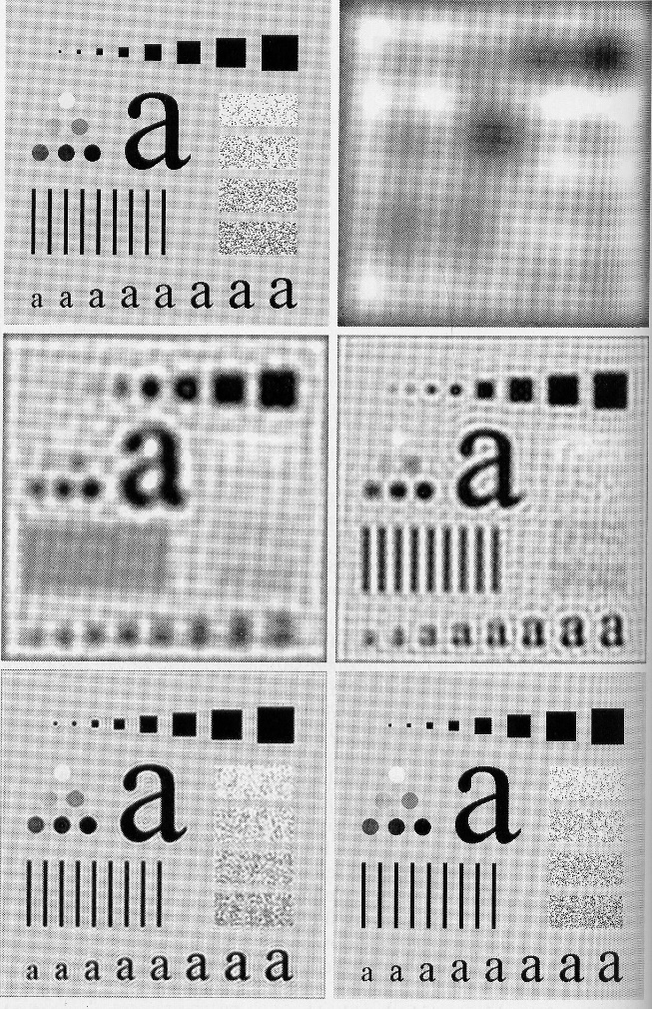
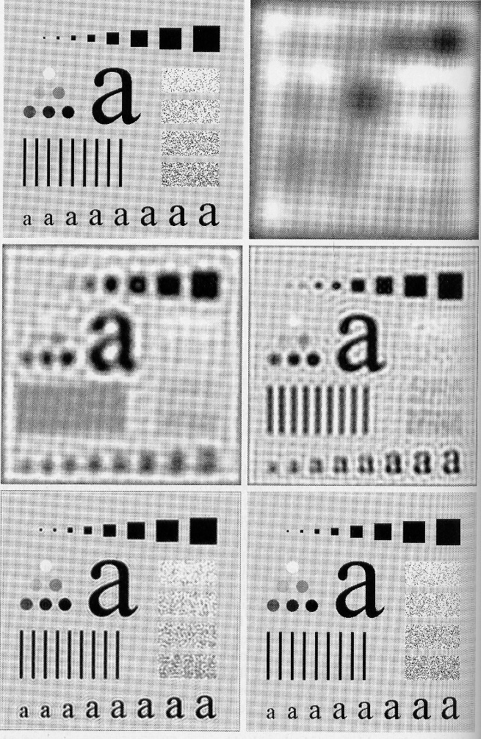
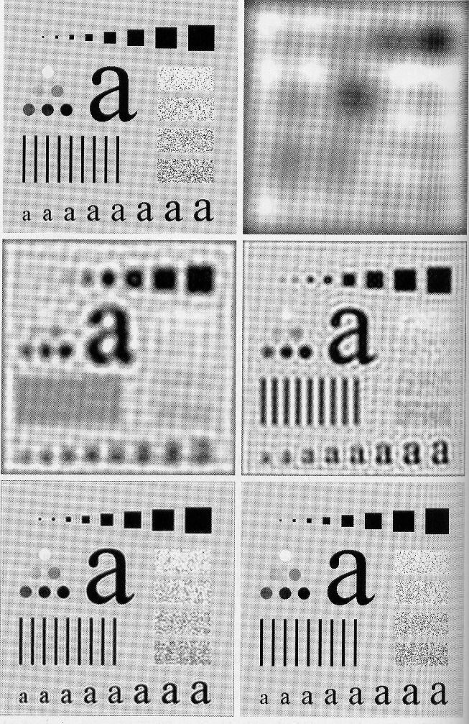
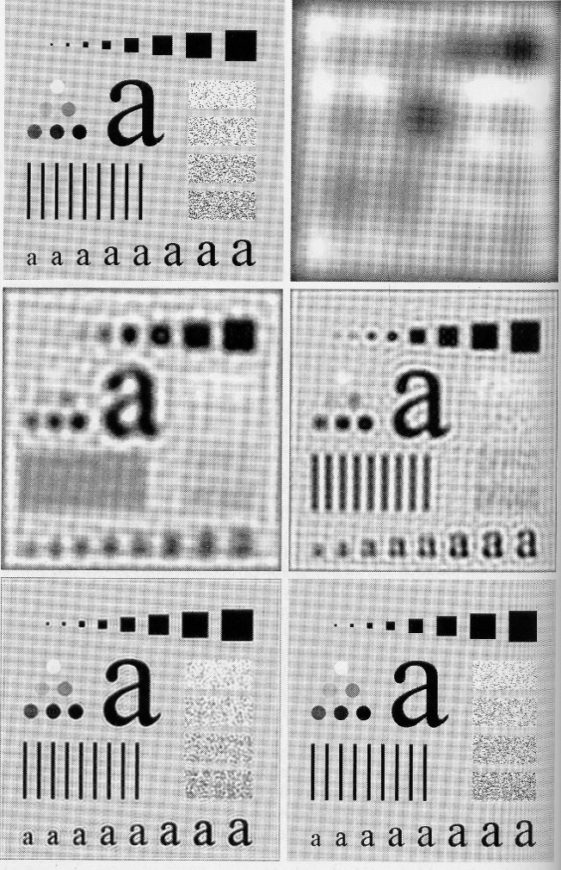
ILPF results
Original image

Slide 58
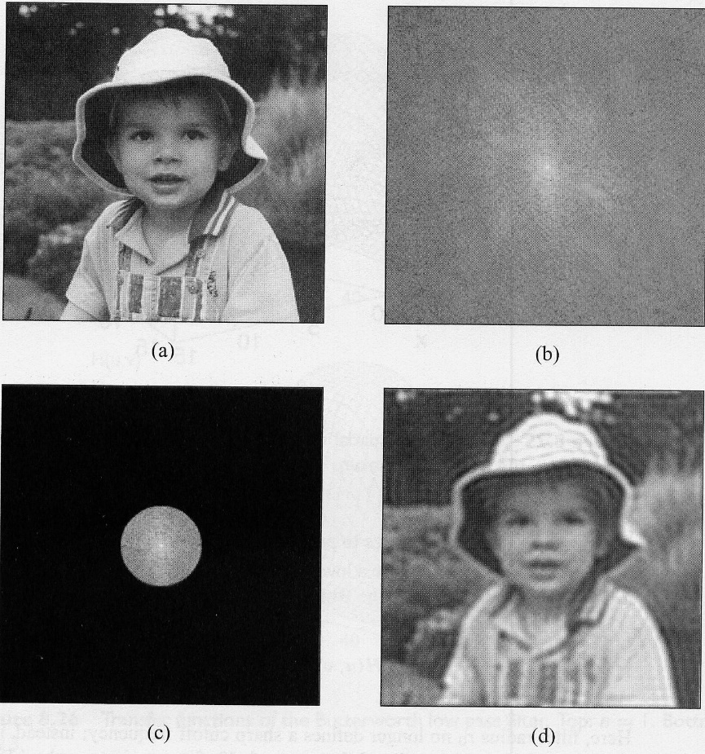
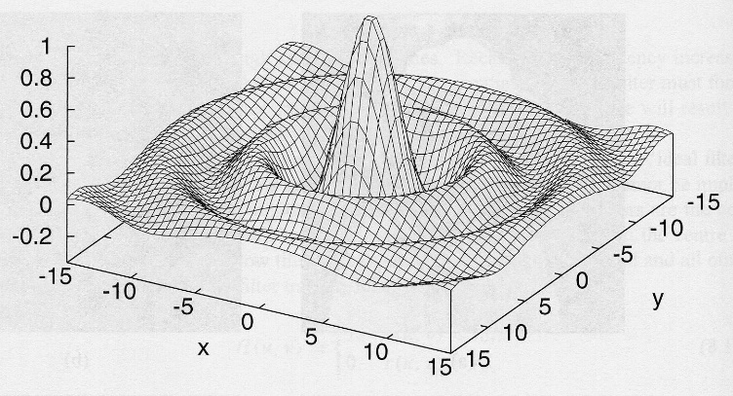
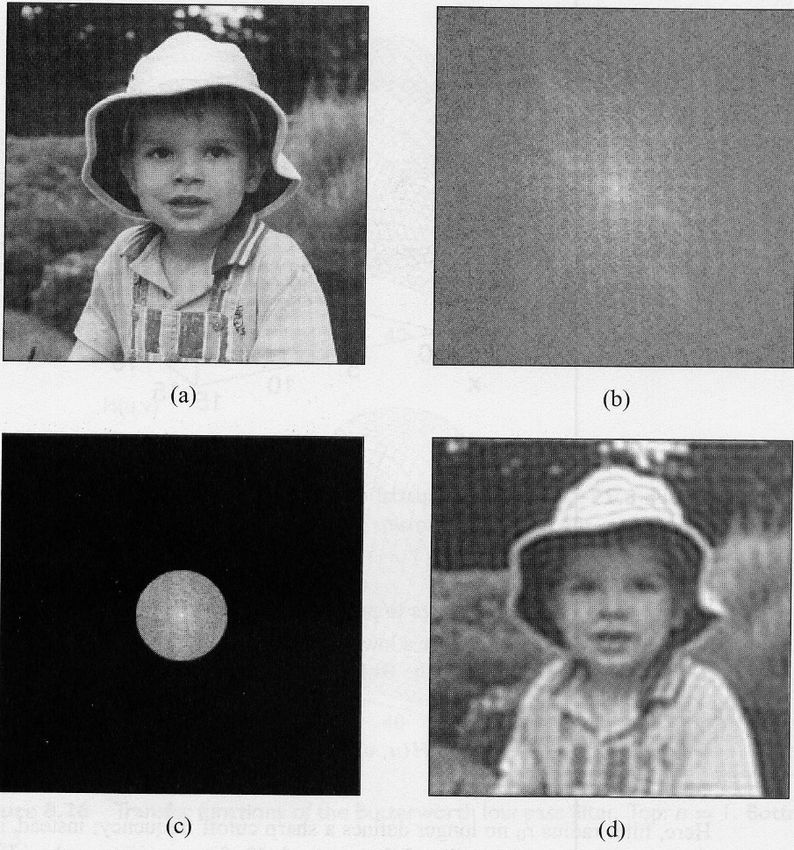
ILPF ripple effects
DFT
Original image [f(x,y)]
F(u,v)
H(u,v)
G(u,v) = F(u,v) H(u,v)
f * h
Inverse DFT
h(x,y)
g(x,y)

Slide 59
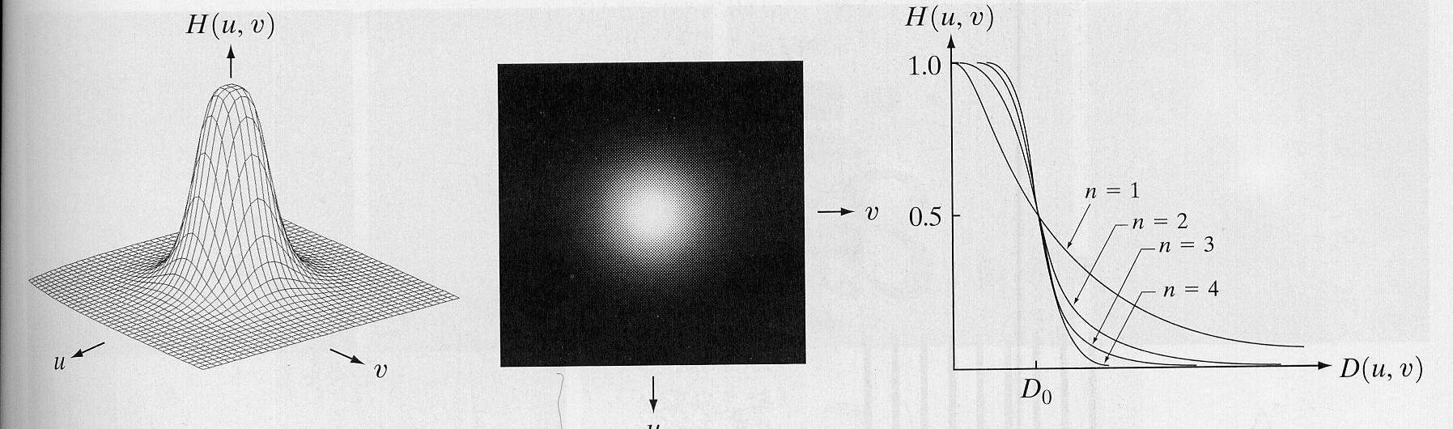
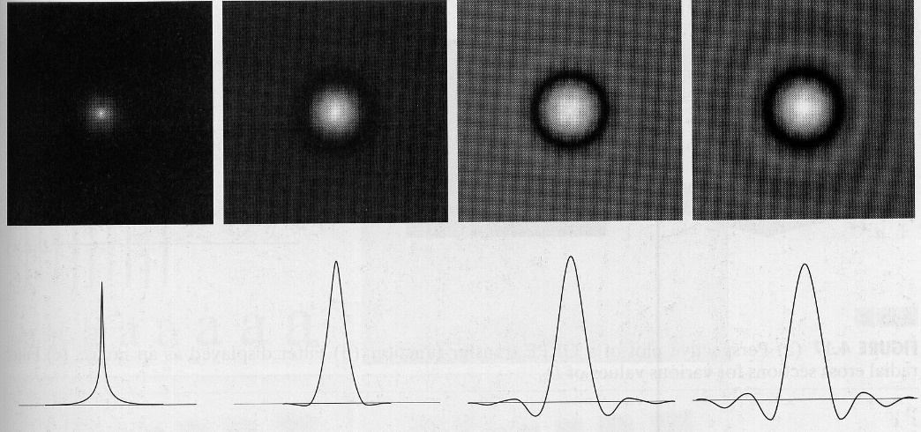
Butterworth Low Pass Filter (BLPF)
h(x,y)
n = 1
n = 2
n = 3
n = 4

Slide 60
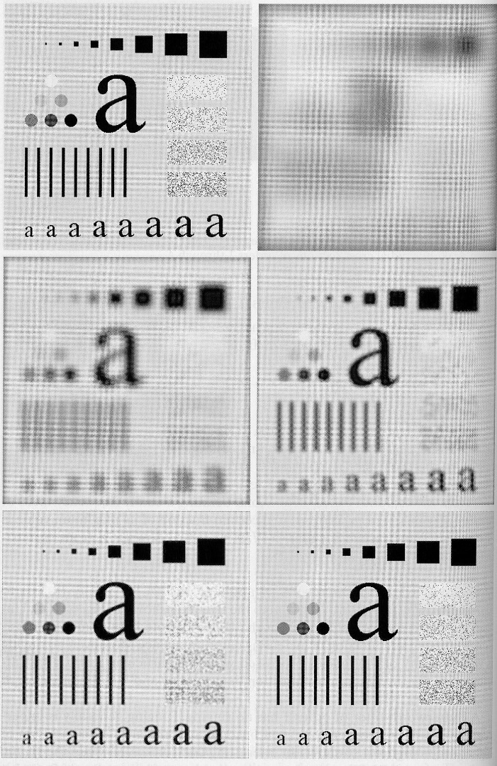
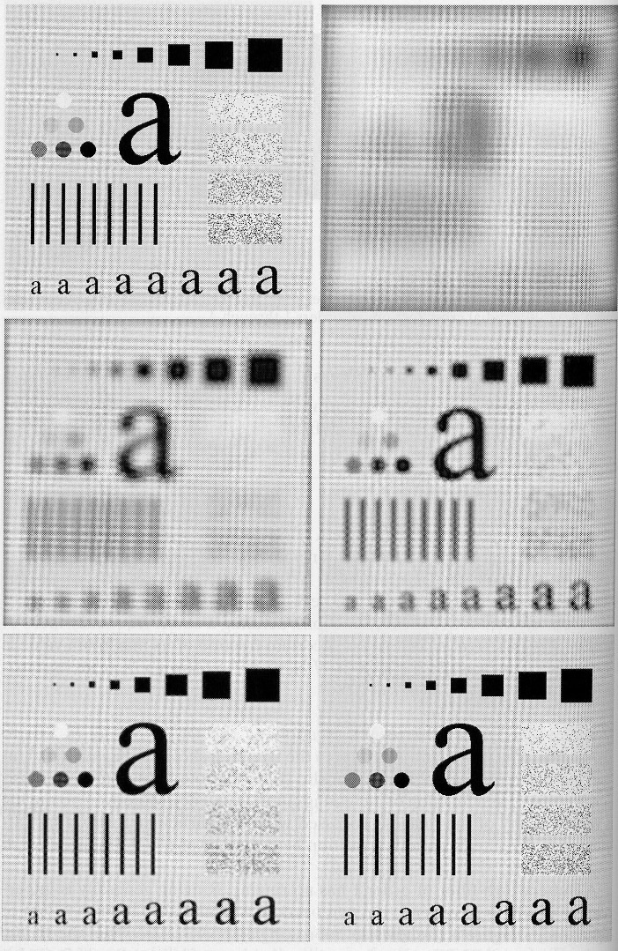

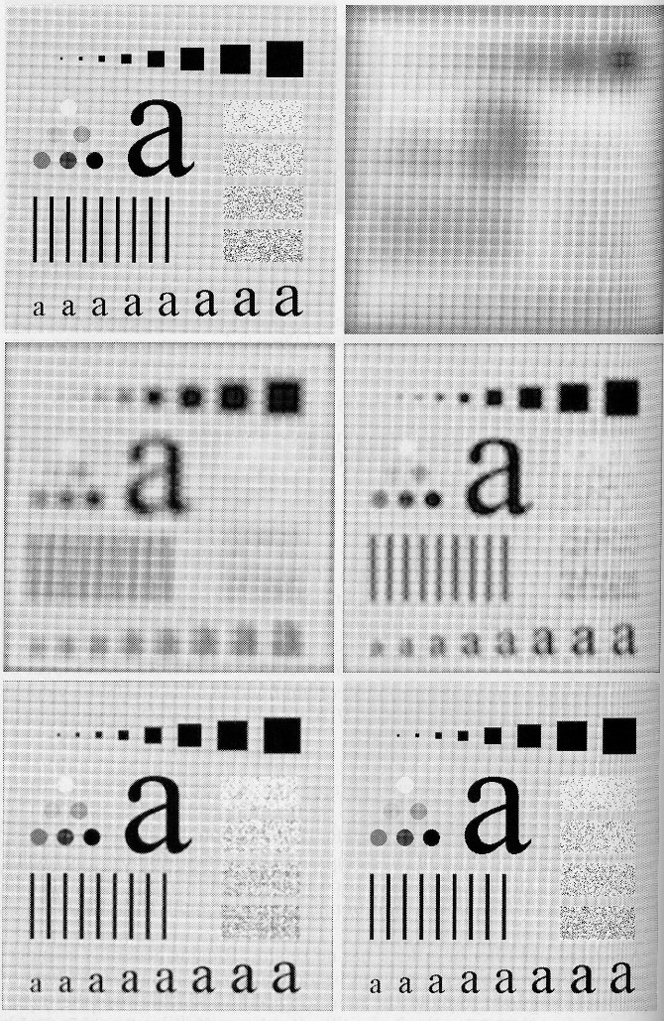

BLPF results
n = 2
Original image

Slide 61
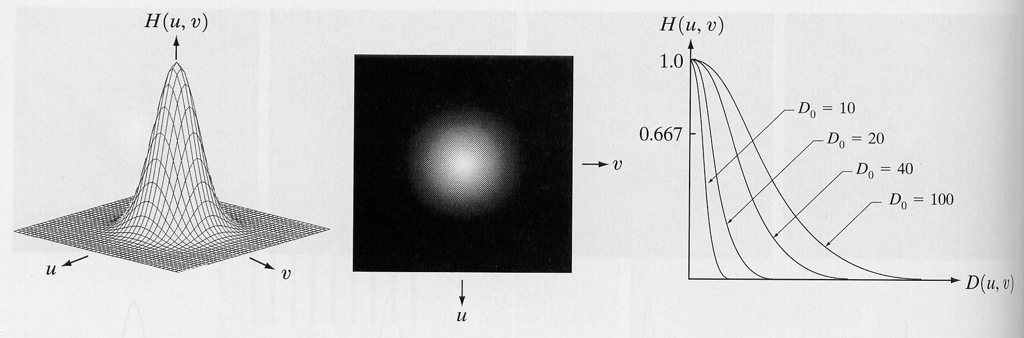
Gaussian Low Pass Filter (GLPF)

Slide 62
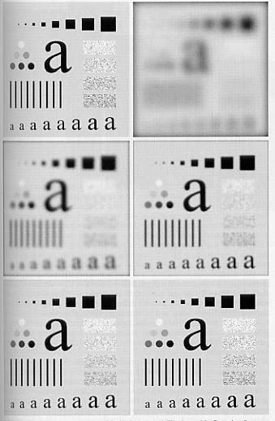
GLPF results
Original image

Slide 63
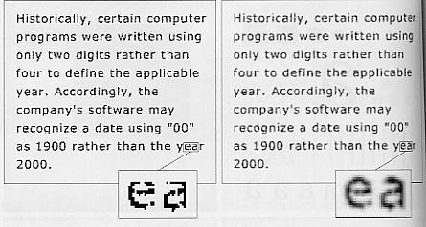
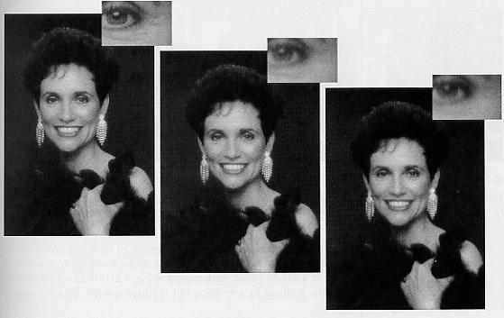
Applications of Low Pass Filter
Character recognition
Picture Studio Decoration

Slide 64
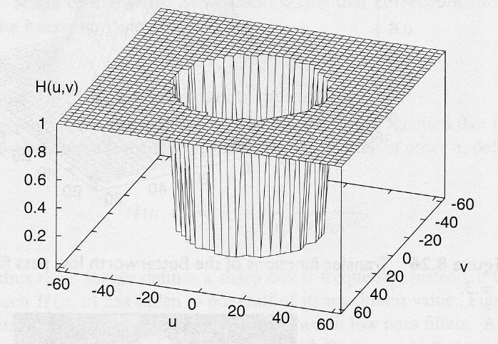
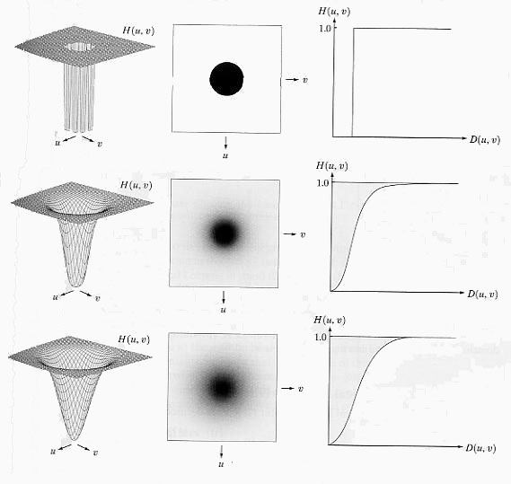
Ideal High Pass Filter (IHPF)

Slide 65

IHPF results

Slide 66
Butterworth High Pass Filter (BHPF)

Slide 67

BHPF results

Slide 68

Gaussian High Pass Filter (GHPF)

Slide 69

GHPF results

Slide 70

Laplacian Filter (Second-order Filter)
h(x,y)

Slide 71

Laplacian Filter results
Laplacian
filter
Laplacian filtered
image
Original image

Slide 72

High Frequency Emphasis Filter
BHPF
f(x,y)
Histogram
equalization

Slide 73

Band Reject Filter (BRF)
Ideal BRF
Butterworth BRF
Gaussian BRF

Slide 74

BRF results
DFT
f(x,y)
F(u,v)
Inverse DFT
F(u,v)H(u,v)
g(x,y)
H(u,v)

Slide 75


Band Pass Filter (BPF)
DFT
f(x,y)
F(u,v)
Inverse DFT
F(u,v)H(u,v)
g(x,y)
H(u,v)

